Slide 1
HashiCorp Vault
TOUHEED AHMED NADAF

Slide 2
Introduction
Deploying HashiCorp Vault on AWS offers a secure, scalable, and cost-effective way to manage secrets. It uses EC2 for hosting, IAM for authentication, and S3 for storage. Vault can dynamically generate and rotate AWS credentials, eliminating hardcoded secrets and improving cloud security. This setup centralizes secret management while leveraging AWS’s flexibility.

Slide 3
What is Vault?
Vault is an identity-based secrets and encryption management system.
Secret: A secret is anything that you want to tightly control access to, such as API encryption keys, passwords, SSH keys, or certificates.
Vault provides encryption services that are gated by authentication and authorization methods.
Using Vault’s UI or CLI access to secrets and other sensitive data can be securely stored and managed, tightly controlled (restricted), and auditable.

Slide 4
Motivation
Cloud use is growing fast.
Secrets like passwords and keys are often kept insecurely.
Manually managing secrets can cause mistakes.
We need a safe and easy way to manage secrets automatically.
Vault helps keep secrets safe across AWS, apps, and services.
This makes cloud systems more secure and reliable.

Slide 5
Problem Statement & Objectives
Problem Statement: Manual management of secrets in AWS cloud environments leads to risks like hardcoded credentials and lack of rotation.
Objectives:
Secure AWS cloud infrastructure
Automate secret injection in CI/CD pipelines
Enable dynamic database credentials
Provide secure access for microservices
Enforce access control via Vault policies

Slide 6
Research Gap
Most existing solutions focus on key storage and third-party auditing but lack automated secrets management, dynamic credential rotation, and CI/CD integration. They do not support real-time secret injection or fine-grained access control for cloud-native applications. This project addresses these gaps using HashiCorp Vault on AWS.

Slide 7
Proposed System Architecture
Vault is central to the system.
Integrated with:
AWS (IAM, EC2): Infra-level security
CI/CD Tools (GitHub): AppRole-based auth
Databases (DynamoDB): Dynamic credential generation
Microservices (Kubernetes): Secure runtime access

Slide 8
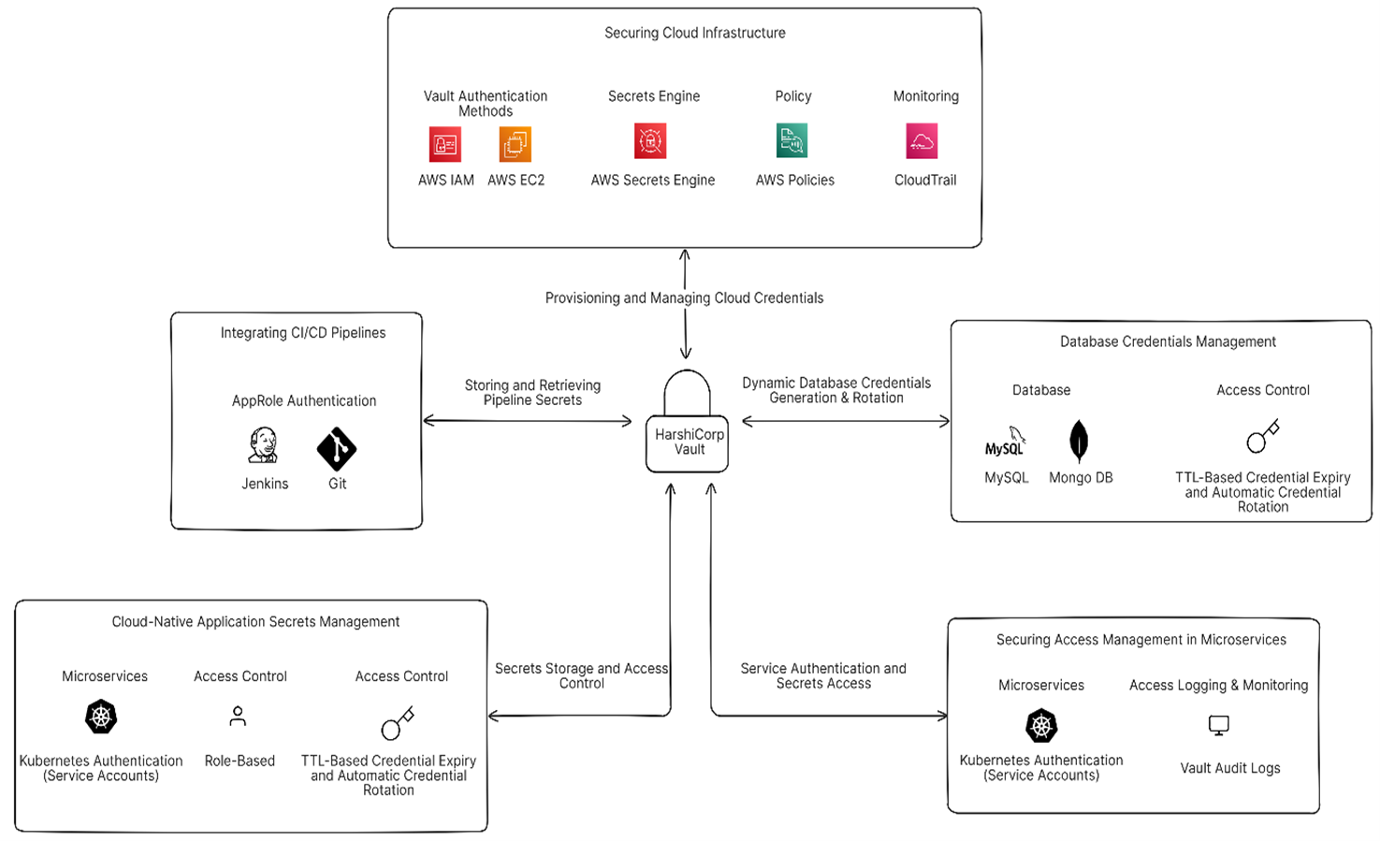
Proposed System Architecture

Slide 9
Roles
Admin: Manages Vault setup, policies, and user access.
DevOps Engineer: Integrates Vault with CI/CD pipelines and automates secrets.
Security Engineer: Implements security policies and monitors secret access.
DB Admin: Manages and rotates database credentials securely using Vault.
Developer: Retrieves and uses secrets securely in applications.

Slide 10
Advantages
Centralized secrets storage
Auto-rotation of credentials
Fine-grained access control
Secure CI/CD integrations
Dynamic authentication for microservices

Slide 11
Software Requirement Specification
Functional Requirements:
Deploy Vault on EC2 via Terraform
Store & rotate AWS credentials
Enable RBAC
Integrate CI/CD & databases
Fetch secrets dynamically
Non-Functional Requirements:
Scalability
Security
Availability
Performance

Slide 12
Software Tools:
HashiCorp Vault
AWS
GitHub
Kubernetes
Python
Hardware:
Intel Core i5
6GB+ RAM
Windows 10 or 11

Slide 13
Future Scope
Multi-cloud support (Azure, GCP)
Advanced IAM integration (Okta, Azure AD)
ML-based anomaly detection
Full container-native support (Docker, Kubernetes)
Dashboard-based secret monitoring

Slide 14
References
HashiCorp Vault Documentation: https://www.vaultproject.io/docs
AWS IAM Documentation: https://docs.aws.amazon.com/IAM/latest/UserGuide/
AWS DynamoDB Documentation: https://docs.aws.amazon.com/amazondynamodb/latest/developerguide/
GitHub Actions Documentation: https://docs.github.com/en/actions

